Slide 1
Junior Interclub Survey Season 2020-2021
Jnr IC 6 Respondents
Squads 4 Respondents

Slide 2
Junior Interclub Survey 4 respondents
Summary
Liked regular playing of tennis
Kids improving
Need more players
Match similar ages for play
Parents to follow etiquette
Better systems for scoring – simplify
100% satisfied with format and leagues, communication and THS
More than 80% likely or very likely to play next season

Slide 3
How likely is it that you would recommend NBS Junior Interclub to a friend or colleague? NPS
NPS 0
4 respondents only

Slide 4
What did you like most about this NBS Junior Interclub season?
Children can play the sport they love and improve with every match
Playing tennis each weekend
It was enjoyed by the kids, the competition was fair & competitive.
Regular playing opportunities
My child improved tennis skills very well by actually playing games.

Slide 5
How can we improve the NBS Junior Interclub competition?
Attract more competitors :-) And provide the balls to play
Getting more players involved
Have better systems in place. Many scores weren't entered until the last week. It was a scramble to remember scores, as the responsible person hadn't entered them. Score sheets MUST be filled in and signed by both teams, then entered on that day & handed to junior convenor. Players need to commit to the season instead of all these make up games weeks later. I understand that some absences are unavoidable, so give teams a week to make up a game or they forfeit.
We'd like ALL parents not to speak out during the games. As we came across a couple who didn't care about the rule not to be part of it and let players to own the game/ judgement. So if you could communicate all parents and care takers thoroughly about it, it'd be appreciated.
have kids of the same age playing each other, no point having 9yr olds playing 12/13 year olds

Slide 6
In your opinion, what can we improve on for the organisation of the junior interclub next season?
As per above. Tennis rules, policy & etiquette need to be enforced. It seemed to me that parents made up some of their own rules as they go. -Parents should NEVER be on court. -If a player keeps another player waiting on court for over 30 mins because they decided to go home and change/ have something to eat / whatever the reason was. Why was he allowed to take the court? He should have had to forfeit. That was not nice to witness. (If it was my child I would not have put up with that)
Have ALL parents phone numbers available to managers so that managers can contact easily...sometimes took a bit of chasing to find contact details.
Organisation was really good. Thank you.
it was organised quite well so no improvements there
All good

Slide 7
Are you satisfied with the format and leagues offered this season?
Yes 100%

Slide 8
How would you improve the current format, leagues next season?
A girl and a boy format worked quite well in a team

Slide 9
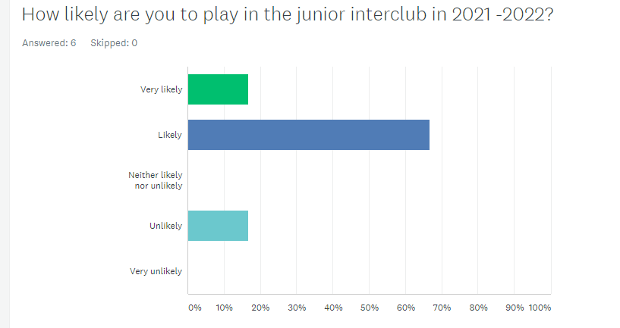
How likely are you to play in the junior interclub in 2021 -2022?
Very likely 16.67%
Likely 66.67%
Neither likely nor unlikely 0%
Unlikely 16.67%

Slide 10
Communication to families and clubs: Were you satisfied?
Yes 100%

Slide 11
Were you happy with the organisation of Tennis Hot Shots this year?
Yes 100%

Slide 12
Junior Squads Survey 4 respondents
Summary
Organisation: 75% well organised, 25% need improvement
Liked coaching and extra trainings (strength & conditioning and nutrition)
Want more coaching, tactics training and strength & conditioning
Goal of squads is improving skills, match play, team development
Training: 1 time per week in Terms 1,2,3,4 (50%) or 1,2,4, (50%)
All likely to play next season
Improvement: make it more challenging

Slide 13
How likely is it that you would recommend NBTA Junior Squads Program to a friend or colleague?
NPS -50
4 respondents

Slide 14
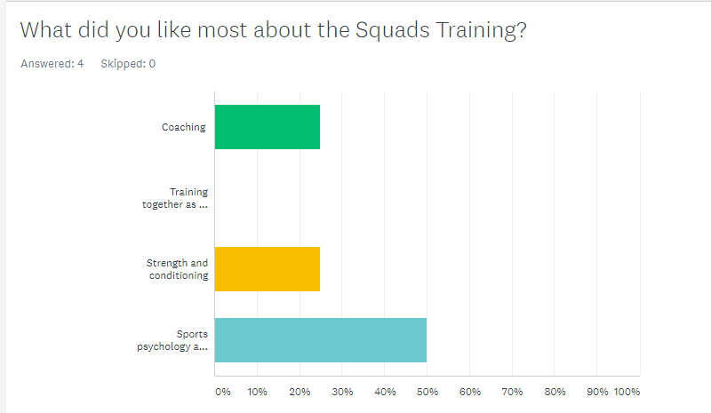
What did you like most about the Squads Training?

Slide 15
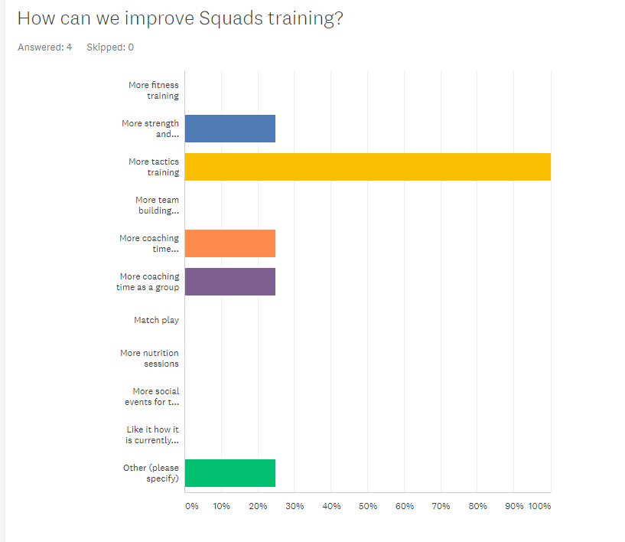
How can we improve Squads training?

Slide 16
In your opinion, what is the goal of the squads program?
Build relationships with other kids and improve match play
Improve skills
Improve players ability and enhance group team building
Development

Slide 17
How many sessions per week should the junior squads training include?
1 = 100%
2
3
More than 3

Slide 18
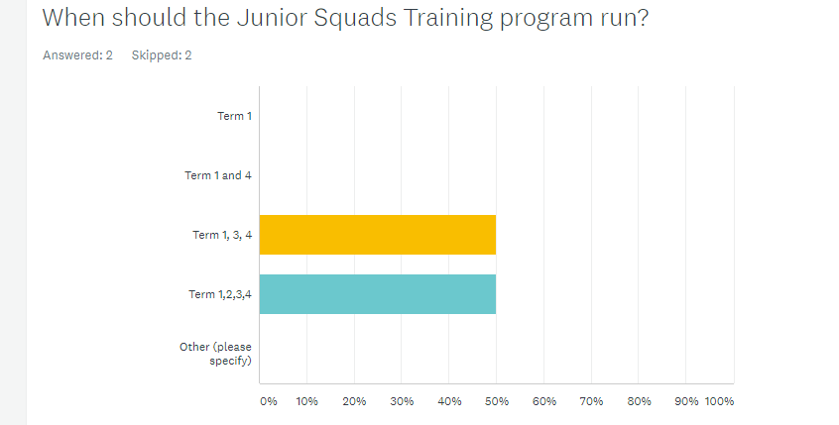
When should the Junior Squads Training program run?

Slide 19
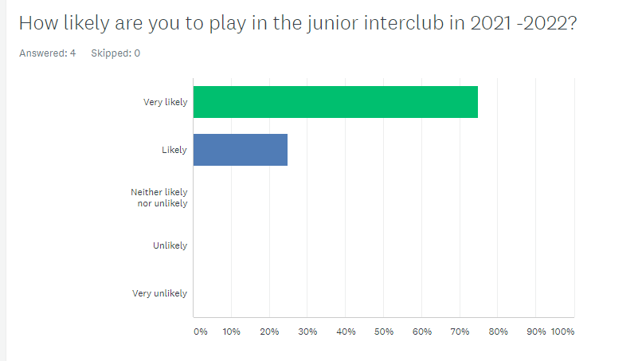
How likely are you to play in the junior interclub in 2021 -2022?

Slide 20
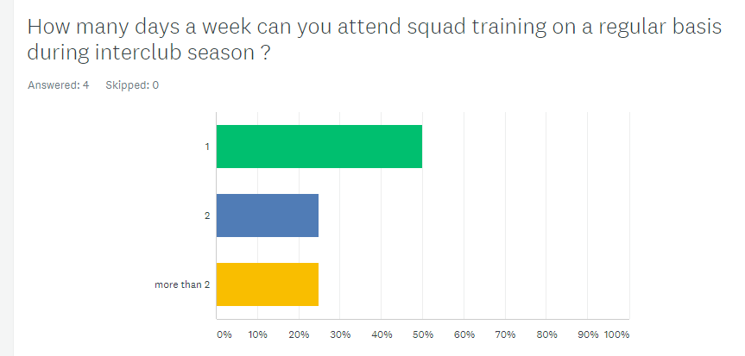
How many days a week can you attend squad training on a regular basis during interclub season ?

Slide 21
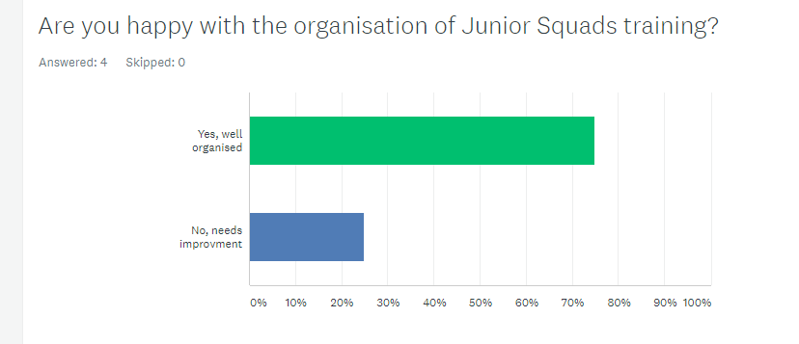
Are you happy with the organisation of Junior Squads training?

Slide 22
If you could change 2 things about the way squads training is run or works, what would they be?
More challenging, more tactical training
Nothing
Challenge players more on their ability even if older teenager players are asked to join from time to time to improve ability of juniors

