Slide 1
MITCHELL PARK DEVELOPMENT Club Presentation 2021

Slide 2
2
MITCHELL PARK DEVELOPMENT PRESENTATION
SEEKING CLUB APPROVAL FOR PROJECT TO PROCEED:
PROJECT SCOPE
Pavilion & parking solution (strengthening & access)
Indoor court structure solution
DESIGN SOLUTION
STAGED BUILD APPROACH
BUDGET & FINANCIAL AUTHORITY
COUNCIL FUNDING CONDITIONS
PROJECT TERMS OF REFERENCE
PROJECT MANAGEMENT STRUCTURE
PROJECT SCHEDULE
MITCHELL PARK DEVELOPMENT
Club Presentation 2021

Slide 3
3
1. PROJECT SCOPE
The following slide outlines the parameters of the project and the plan to address the key strategic issues facing HVT.
MITCHELL PARK DEVELOPMENT
Club Presentation 2021

Slide 4
1. PROJECT SCOPE: ADDRESS 2 STRATEGIC ISSUES
4
Patron Safety and Access
= Pavilion Upgrade and Parking
earthquake strengthening & improved access
Financial Sustainability
= Indoor Court Structure
increased revenue via court/facility hire
all weather play, iconic structure
MITCHELL PARK DEVELOPMENT
Club Presentation 2021

Slide 5
5
2. DESIGN SOLUTION
The Mitchell Park Development Group seek approval to proceed with delivering the facility upgrades illustrated in the following visuals.
MITCHELL PARK DEVELOPMENT
Club Presentation 2021

Slide 6
2. DESIGN SOLUTION: FUNDING MODEL IMPACT
6
A new funding model was required due to changes in Council funding priorities, the COVID emergency and build industry cost escalation
The new funding model developed in partnership by HCC/HVT will require an alteration to our overall Mitchell Park site plan
Core funding will now be secured via the sale of a small component of Mitchell Park reserve status land requiring an adjustment by Council to our lease
Upon HVT full support of the plan the Council will engage in a revocation process to change the designated land area title so it can be sold
Net proceeds from the land sale will be passed onto HVT by HCC to help fund our project
MITCHELL PARK DEVELOPMENT
Club Presentation 2021

Slide 7
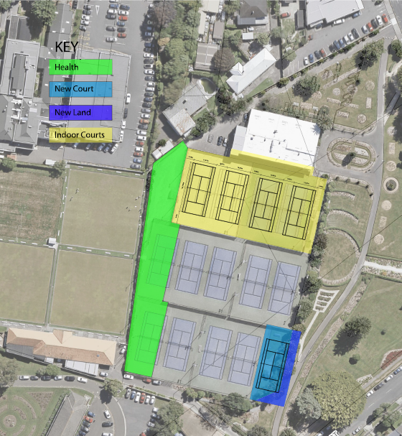
2. DESIGN SOLUTION: MITCHELL PARK SITE PLAN
7
Revocation and sale of reserve land
Approximately 1,600sqm of land will be sold to the neighboring Hutt Valley Health Centre
The HVT leased land to be sold consists of the tennis Court 4 carpark plus most of tennis Courts 9 and 13 (Green area)
Net proceeds from the sale towards our development is estimated at $1.25m
Our lease will be adjusted to reinstate 1 tennis court in the South-east corner taking the total court count back to 12
MITCHELL PARK DEVELOPMENT
Club Presentation 2021

Slide 8
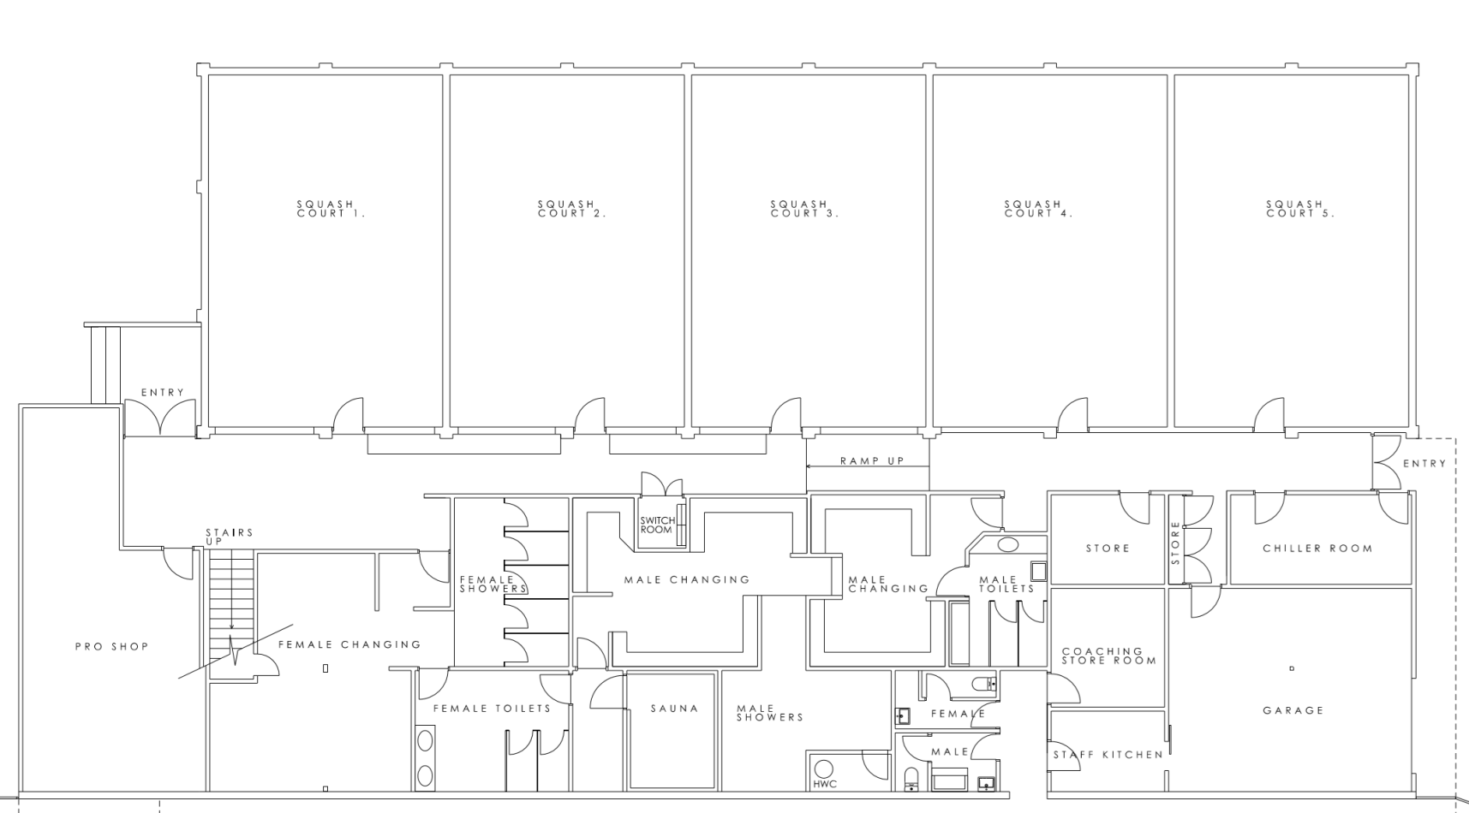
8
2. DESIGN SOLUTION: CURRENT PAVILION
MITCHELL PARK DEVELOPMENT
Club Presentation 2021

Slide 9
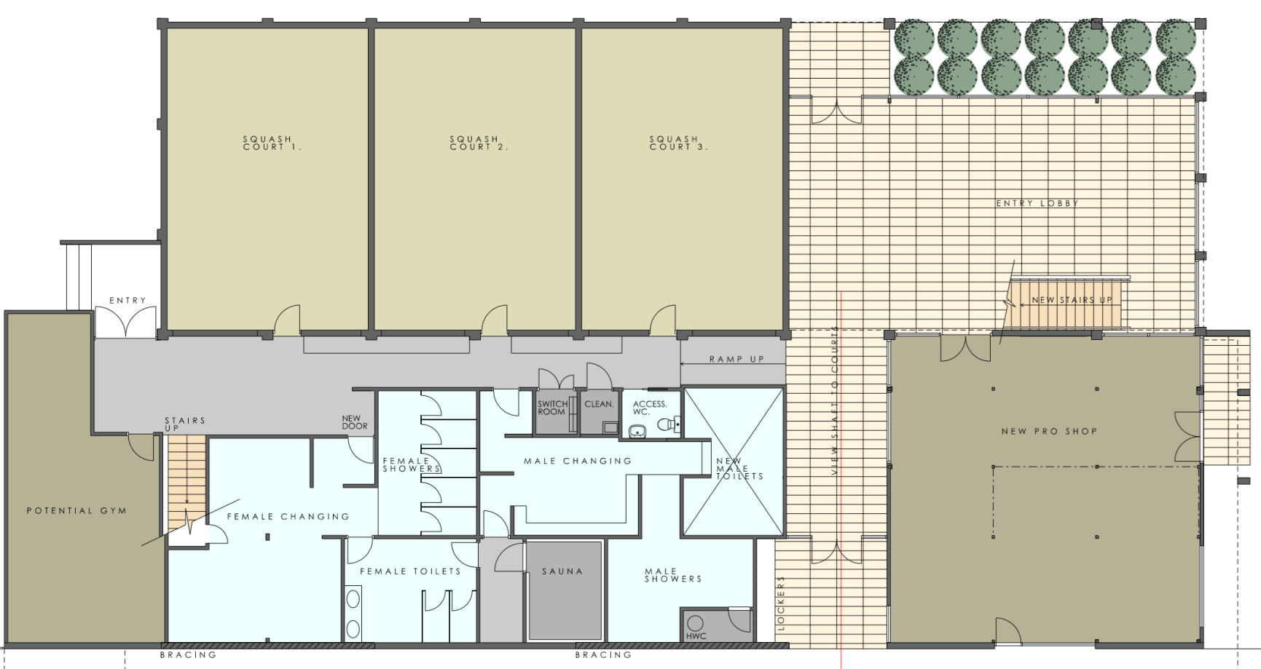
9
2. DESIGN SOLUTION: PAVILION
MITCHELL PARK DEVELOPMENT
Club Presentation 2021

Slide 10
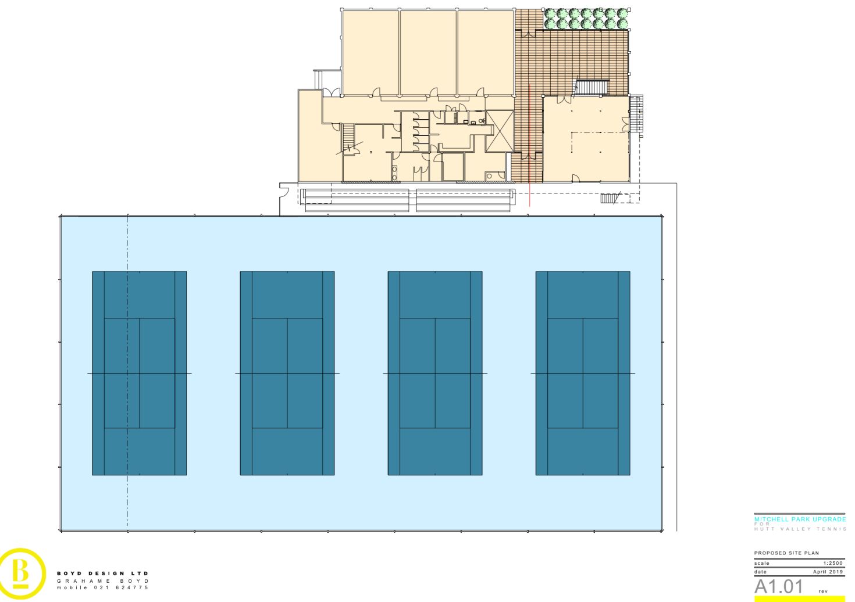
10
2. DESIGN SOLUTION: PAVILION/COURTS
MITCHELL PARK DEVELOPMENT
Club Presentation 2021

Slide 11
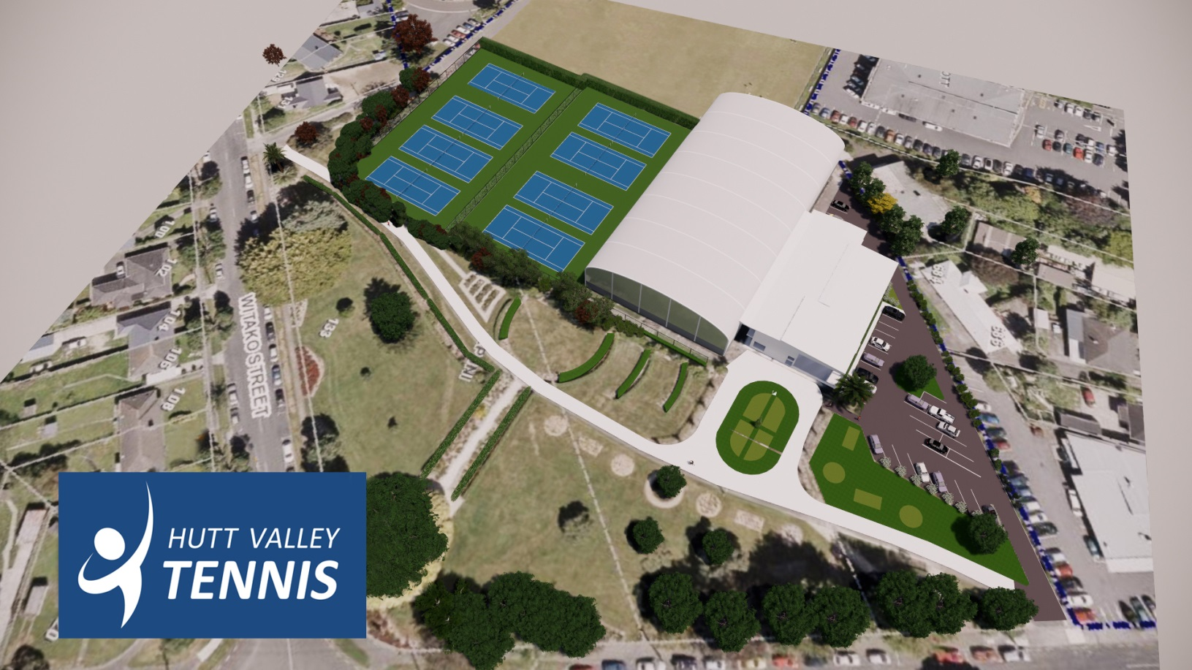
11
2. DESIGN SOLUTION: MITCHELL PARK SITE
Edit visual to show land title change…
MITCHELL PARK DEVELOPMENT
Club Presentation 2021

Slide 12
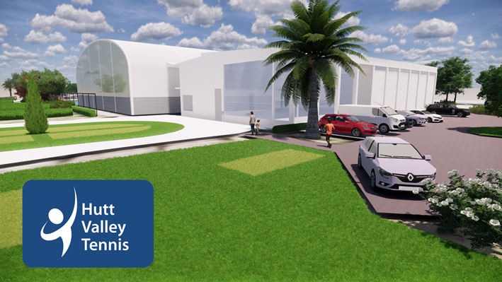
12
2. DESIGN SOLUTION: PAVILION/PARKING/INDOOR COURTS
MITCHELL PARK DEVELOPMENT
Club Presentation 2021

Slide 13
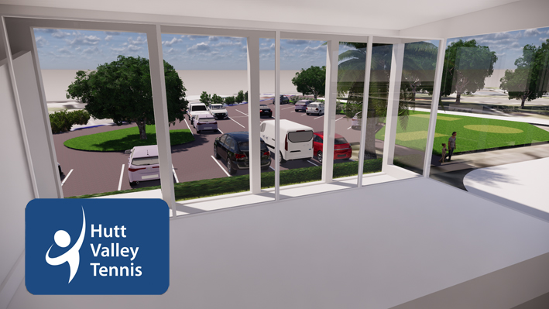
13
2. DESIGN SOLUTION: PAVILION FOYER
MITCHELL PARK DEVELOPMENT
Club Presentation 2021

Slide 14
14
2. DESIGN SOLUTION: INDOOR COURT STRUCTURE
MITCHELL PARK DEVELOPMENT
Club Presentation 2021

Slide 15
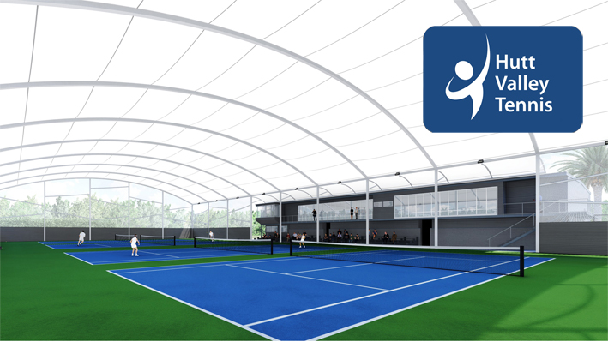
15
2. DESIGN SOLUTION: INDOOR COURT STRUCTURE
MITCHELL PARK DEVELOPMENT
Club Presentation 2021

Slide 16
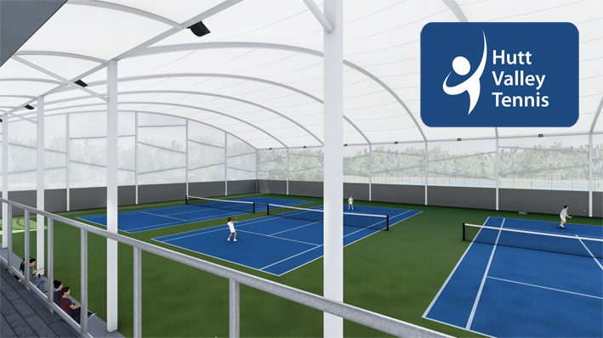
16
2. DESIGN SOLUTION: INDOOR COURT STRUCTURE
MITCHELL PARK DEVELOPMENT
Club Presentation 2021

Slide 17
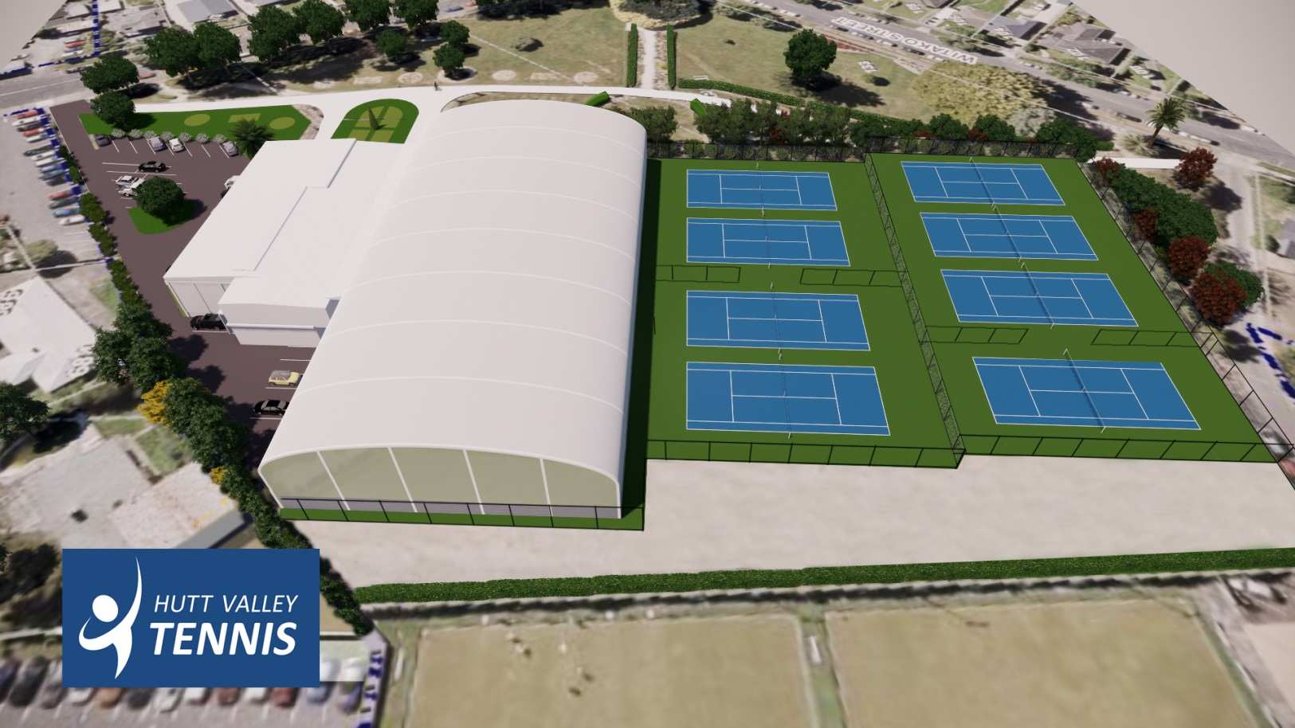
17
2. DESIGN SOLUTION: MITCHELL PARK SITE
Edit visual to show land title change…
MITCHELL PARK DEVELOPMENT
Club Presentation 2021

Slide 18
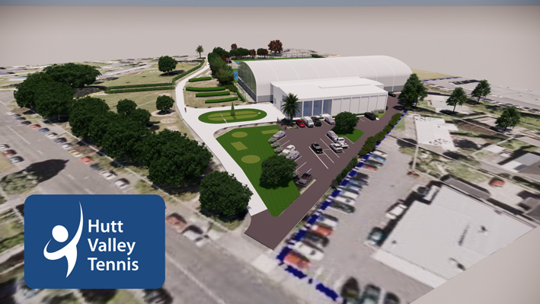
18
2. DESIGN SOLUTION: MITCHELL PARK SITE
MITCHELL PARK DEVELOPMENT
Club Presentation 2021

Slide 19
19
3. STAGED BUILD APPROACH
Changes in Council funding priorities, COVID and cost escalation across the construction industry has forced changes to how we deliver the plan.
MITCHELL PARK DEVELOPMENT
Club Presentation 2021

Slide 20
3. STAGED BUILD APPROACH
20
The Development Group recommends a staged build plan
Stage 1: Indoor Court structure
Stage 2: Pavilion earthquake strengthening
Upgrade Pavilion to be code compliant (Council funding requirement)
The approach will reduce the risk of cost escalation and provide additional time to raise funds for the Pavilion Upgrade
Non-essential build components will be deferred until required funding is secured
Internal Pavilion refit works to improve access
New Tennis Court 9 (12th Court)
Re-instating floodlights to Tennis Courts 8 and 12
MITCHELL PARK DEVELOPMENT
Club Presentation 2021

Slide 21
21
3. STAGED APPROACH: STAGE 1 - INDOOR COURTS
Prioritising the indoor court build will reduce cost escalation risk as it represents 80% of the total project budget.
The Indoor Courts will significantly increase revenue streams via new court hire and sponsorship opportunities
Private hire, coaching, small format tournaments, leagues, birthdays, tennis aerobics
Improved business house competitions that can run uninterrupted year-round
Iconic structure that will increase the profile of tennis and services offered at the site that can be leveraged e.g. new sponsorship, commercial or future partner relationships
New revenue streams will help with HVT fundraising efforts for the Pavilion redesign
MITCHELL PARK DEVELOPMENT
Club Presentation 2021

Slide 22
22
4. BUDGET AND FINANCIAL AUTHORITY
Mitchell Park Development Committee is seeking Club approval for the project approach and financial authority to deliver the plan.
MITCHELL PARK DEVELOPMENT
Club Presentation 2021

Slide 23
23
4. BUDGET: STAGES 1 & 2
STAGE 1 & 2: FUNDING PLAN | $
Hutt Valley Tennis (Development Fund) | $ 450,000
Hutt City Council Funds | $ 500,000
Health Hub Land Sale (Developer) | $ 1,250,000
Hutt Valley Tennis (Grants, Sponsors & Fundraising) | $ 370,000
TOTAL | $ 2,570,000
STAGE 1 & 2: DESIGN & BUILD BUDGET | $
Indoor Tennis Court Structure | $ 1,700,000
Groundworks (Playing Surface & Car Parking) | $ 350,000
Pavilion Strengthening & Access | $ 450,000
Professional Fees & Contingency | $ 70,000
* Lights Installation - Courts 8 & 12 | $ 60,000*
* New Court 9 (Lights & Fencing) | $ 120,000*
TOTAL | $ 2,570,000
HVT Savings available for MP Development
HCC Grant – conditional to delivery of project
Approximate net land sale funds for HVT
HVT fundraising requirement
Tight budget: Indoor Courts: turn-key solution, Pavilion: structural upgrades & access only
*Deferred works due to funding shortfall
MITCHELL PARK DEVELOPMENT
Club Presentation 2021

Slide 24
24
4. BUDGET: STAGED PLAN
STAGE 1. INDOOR COURT BUDGET | $
Indoor Tennis Court Structure | $ 1,700,000
Groundworks (Playing Surface) | $ 220,000
Groundworks (Car Parking) | $ 130,000
Professional Fees | $ 10,000
Contingency | $ 20,000
TOTAL* | $ 2,080,000
STAGE 2. PAVILION DESIGN & BUILD BUDGET | $
Pavilion Strengthening & Access | $ 450,000
Professional Fees | $ 20,000
Contingency | $ 20,000
TOTAL* | $ 490,000
*Total Funds available to HVT if MP land sale is successful & HCC funds released: = $ 2,200,000
*Minimum HVT fundraising required to strengthen pavilion = $ 370,000
MITCHELL PARK DEVELOPMENT
Club Presentation 2021

Slide 25
25
4. BUDGET: FUNDING MODEL
PROJECT FUNDING | FUNDING TARGETS |  | FUNDING PLAN
HVT (Development Fund) | $ 450,000 |  | HVT asset replacement funds set aside and ready for use
Hutt City Council (Grant) | $ 500,000 |  | Hutt City Council grant approved for HVT use
Health Hub Land Sale (Developer) | $ 1,250,000 |  | Approx. net proceeds from proposed MP land sale consisting of tennis courts 9, 13 and the tennis court 4 car park.
HVT (Sponsors & Fundraising) | $ 170,000 |  | Mixed model approach - naming rights, private sponsorship, fundraising events, signage, business, private donations.
HVT (Grant Organisations) | $ 200,000 |  | Community grant organisations, NZ lotteries
TOTAL | $ 2,570,000
O
O
O
O
Upon Club support of the plan the Development Group will commence its fundraising plans to raise the funding shortfall of $370k
The fundraising plan will be extensive with funds sought via multiple channels
Every attempt will be made to secure funds via non-competing club sources
MITCHELL PARK DEVELOPMENT
Club Presentation 2021

Slide 26
26
5. COUNCIL FUNDING CONDITIONS
Mitchell Park Development Committee are seeking Association approval for the group to work with Council representatives to deliver the plan and the most desirable outcome for HVT.
MITCHELL PARK DEVELOPMENT
Club Presentation 2021

Slide 27
27
5. COUNCIL FUNDING CONDITIONS
Total funding contributions from HCC consist of:
$500k financial grant
$1.25m being the approximate net proceeds from the land sale
Formal approval of a final design concept
Evidence and comfort regarding the budget to deliver the Indoor Court Structure and Pavilion steel upgrades, and confirmed or committed fundraising
Evidence and comfort of the construction programme and methodology
Formal approval of a project governance structure
A senior Council Officer sitting on an appropriate Project Control Group
Formal approval of a business case that demonstrates the ongoing operational sustainability and maintenance of the facility by HVT
MITCHELL PARK DEVELOPMENT
Club Presentation 2021

Slide 28
28
6. PROJECT TERMS OF REFERENCE
The following slide details the parameters of the project and outlines the roles and responsibilities of the team and how it will function.
MITCHELL PARK DEVELOPMENT
Club Presentation 2021

Slide 29
29
6. PROJECT TERMS OF REFERNCE
Role The Mitchell Park Development Group (MPDG) will be responsible for providing management direction to the project developing indoor tennis courts and pavilion earthquake strengthening at Mitchell Park Racquet Centre; including all decisions to execute the project; issue and risk resolution, allocation of resource (financial and people) and stakeholder management. This will be a decision making working committee that has the mandate to approve all decisions within agreed scope, budget and schedule to deliver the outcome. All key decisions and actions will be minuted. | Membership The committee membership and administrative requirements are as follows: Members > Gary Baird - Chairperson > Phil Fisher > Shane Jackson > Gary Naylor > Grahame Boyd > Finance controller (TBD) > Brendon Smith > Hutt City Council delegate (TBD) Guests To be confirmed for each meeting, within the context of the agenda. The working committee may be supported by a coordinator. Additional attendees may be required to attend on an ad-hoc basis. Quorum: Chair + 4 voting members (60%) Frequency: proposed monthly The chair may add additional members to the committee as needed Projects dimensions Scope: Indoor Court Structure and Pavilion as outlined in council submission Budget $2.57m Build Schedule: Stage 1: all preparation by Jun 2021; project delivery by Nov 2021 Stage 2: all preparation by March 2022, project delivery by Nov 2022
Responsibilities To secure the grant and sponsorship funding as outlined in the submission. To make decisions required by the project, within agreed delegated authorities, scope and schedule. To assist all project workstreams with external stakeholder engagement. To assist the workstreams to resolve issues and risks. The council representative needs to carry full authority to endorse all decisions on behalf of council to meet the requirement as set out by the council decision.
MITCHELL PARK DEVELOPMENT
Club Presentation 2021

Slide 30
30
7. PROJECT MANAGEMENT STRUCTURE
The following project structure is proposed. Key resources will be invited to join project groups when expertise is required or deemed beneficial.
MITCHELL PARK DEVELOPMENT
Club Presentation 2021

Slide 31
31
7. PROJECT MANAGEMENT STRUCTURE
HVT MANAGEMENT COMMITTEE
MP DEVELOPMENT COMMITTEE
FUNDRAISING & SPONSORSHIP GROUP
PAVILION / ACCESS & GROUNDS GROUP
INDOOR COURT STRUCTURE GROUP
Gary Baird - Committee Chair
Shane Jackson
Grahame Boyd
Brendon Smith
Phil Fisher
Gary Naylor
Finance controller (TBD)
Hutt Council delegate (TBD)
.......... ..............
.......... ..............
.......... ..............
.......... ..............
.......... ..............
.......... ..............
.......... ..............
.......... ..............
.......... ..............
.......... ..............
.......... ..............
.......... ..............
MITCHELL PARK DEVELOPMENT
Club Presentation 2021

Slide 32
32
8. PROJECT SCHEDULE
The Development Group is motivated to move quickly on the project in an aim to mitigate risks around cost escalation and in an aim to deliver new revenue streams for HVT.
MITCHELL PARK DEVELOPMENT
Club Presentation 2021

Slide 33
33
8. PROJECT SCHEDULE
2021 |  |  |  |  |  |  |  |  |  |  |  | 2022
Jan | Feb | Mar | Apr | May | Jun | Jul | Aug | Sep | Oct | Nov | Dec | Jan | Feb | Mar | Apr | May | Jun | Jul | Aug | Sep | Oct | Nov | Dec
SGM - Club Project Vote
HCC MP Land Revocation
Land revocation work
Indoor Court Final Design
Quotes, final pricing & consent
STAGE ONE INDOOR PLAN
Indoor Court Fundraising
Grants, sponsors, donors
Council Funding Conditions
HCC approval
Indoor Court & Parking Build
INDOOR COURT BUILD
Build
Indoor Court Operating Model
New operating model developed & implemented
Pavilion Re-Design Plan
Architectural plans & final design
Pavilion Structural Upgrade
Structural engineer plans & final design
STAGE TWO PAVILION PLAN
Pavilion Final Design & Quotes
Quotes, QS, final pricing & consent
Pavilion Fundraising Plan
Grants, sponsors, donors, naming rights
Pavilion Upgrade Build
PAVILION UPGRADE BUILD
Facility Operating Model
New operating model developed & implemented
MITCHELL PARK DEVELOPMENT
Club Presentation 2021

Slide 34
34
9. SPECIAL GENERAL MEETING
A nominated delegate from each Club will be asked to vote on one of two motions at a SGM set for 7pm, Friday, 26 Feb 2021.
MITCHELL PARK DEVELOPMENT
Club Presentation 2021

Slide 35
35
9. SPECIAL GENERAL MEETING: NEXT STEPS
Clubs are being asked to vote for one of the below motions:
Support the Mitchell Park Development Plan:
this decision will enable the project to proceed
Oppose the Mitchell Park Development Plan:
this decision will stop the project and see Council plus Developer funding lost
MITCHELL PARK DEVELOPMENT
Club Presentation 2021

